Slide 1



Beam Direction
$$ℰ_{Stark}$$
$$ℰ_{L2}$$
$$ℰ_{nr}$$
Region 1
Region 2
Region 3

Slide 2
(a)
(b)
(c)

Slide 3
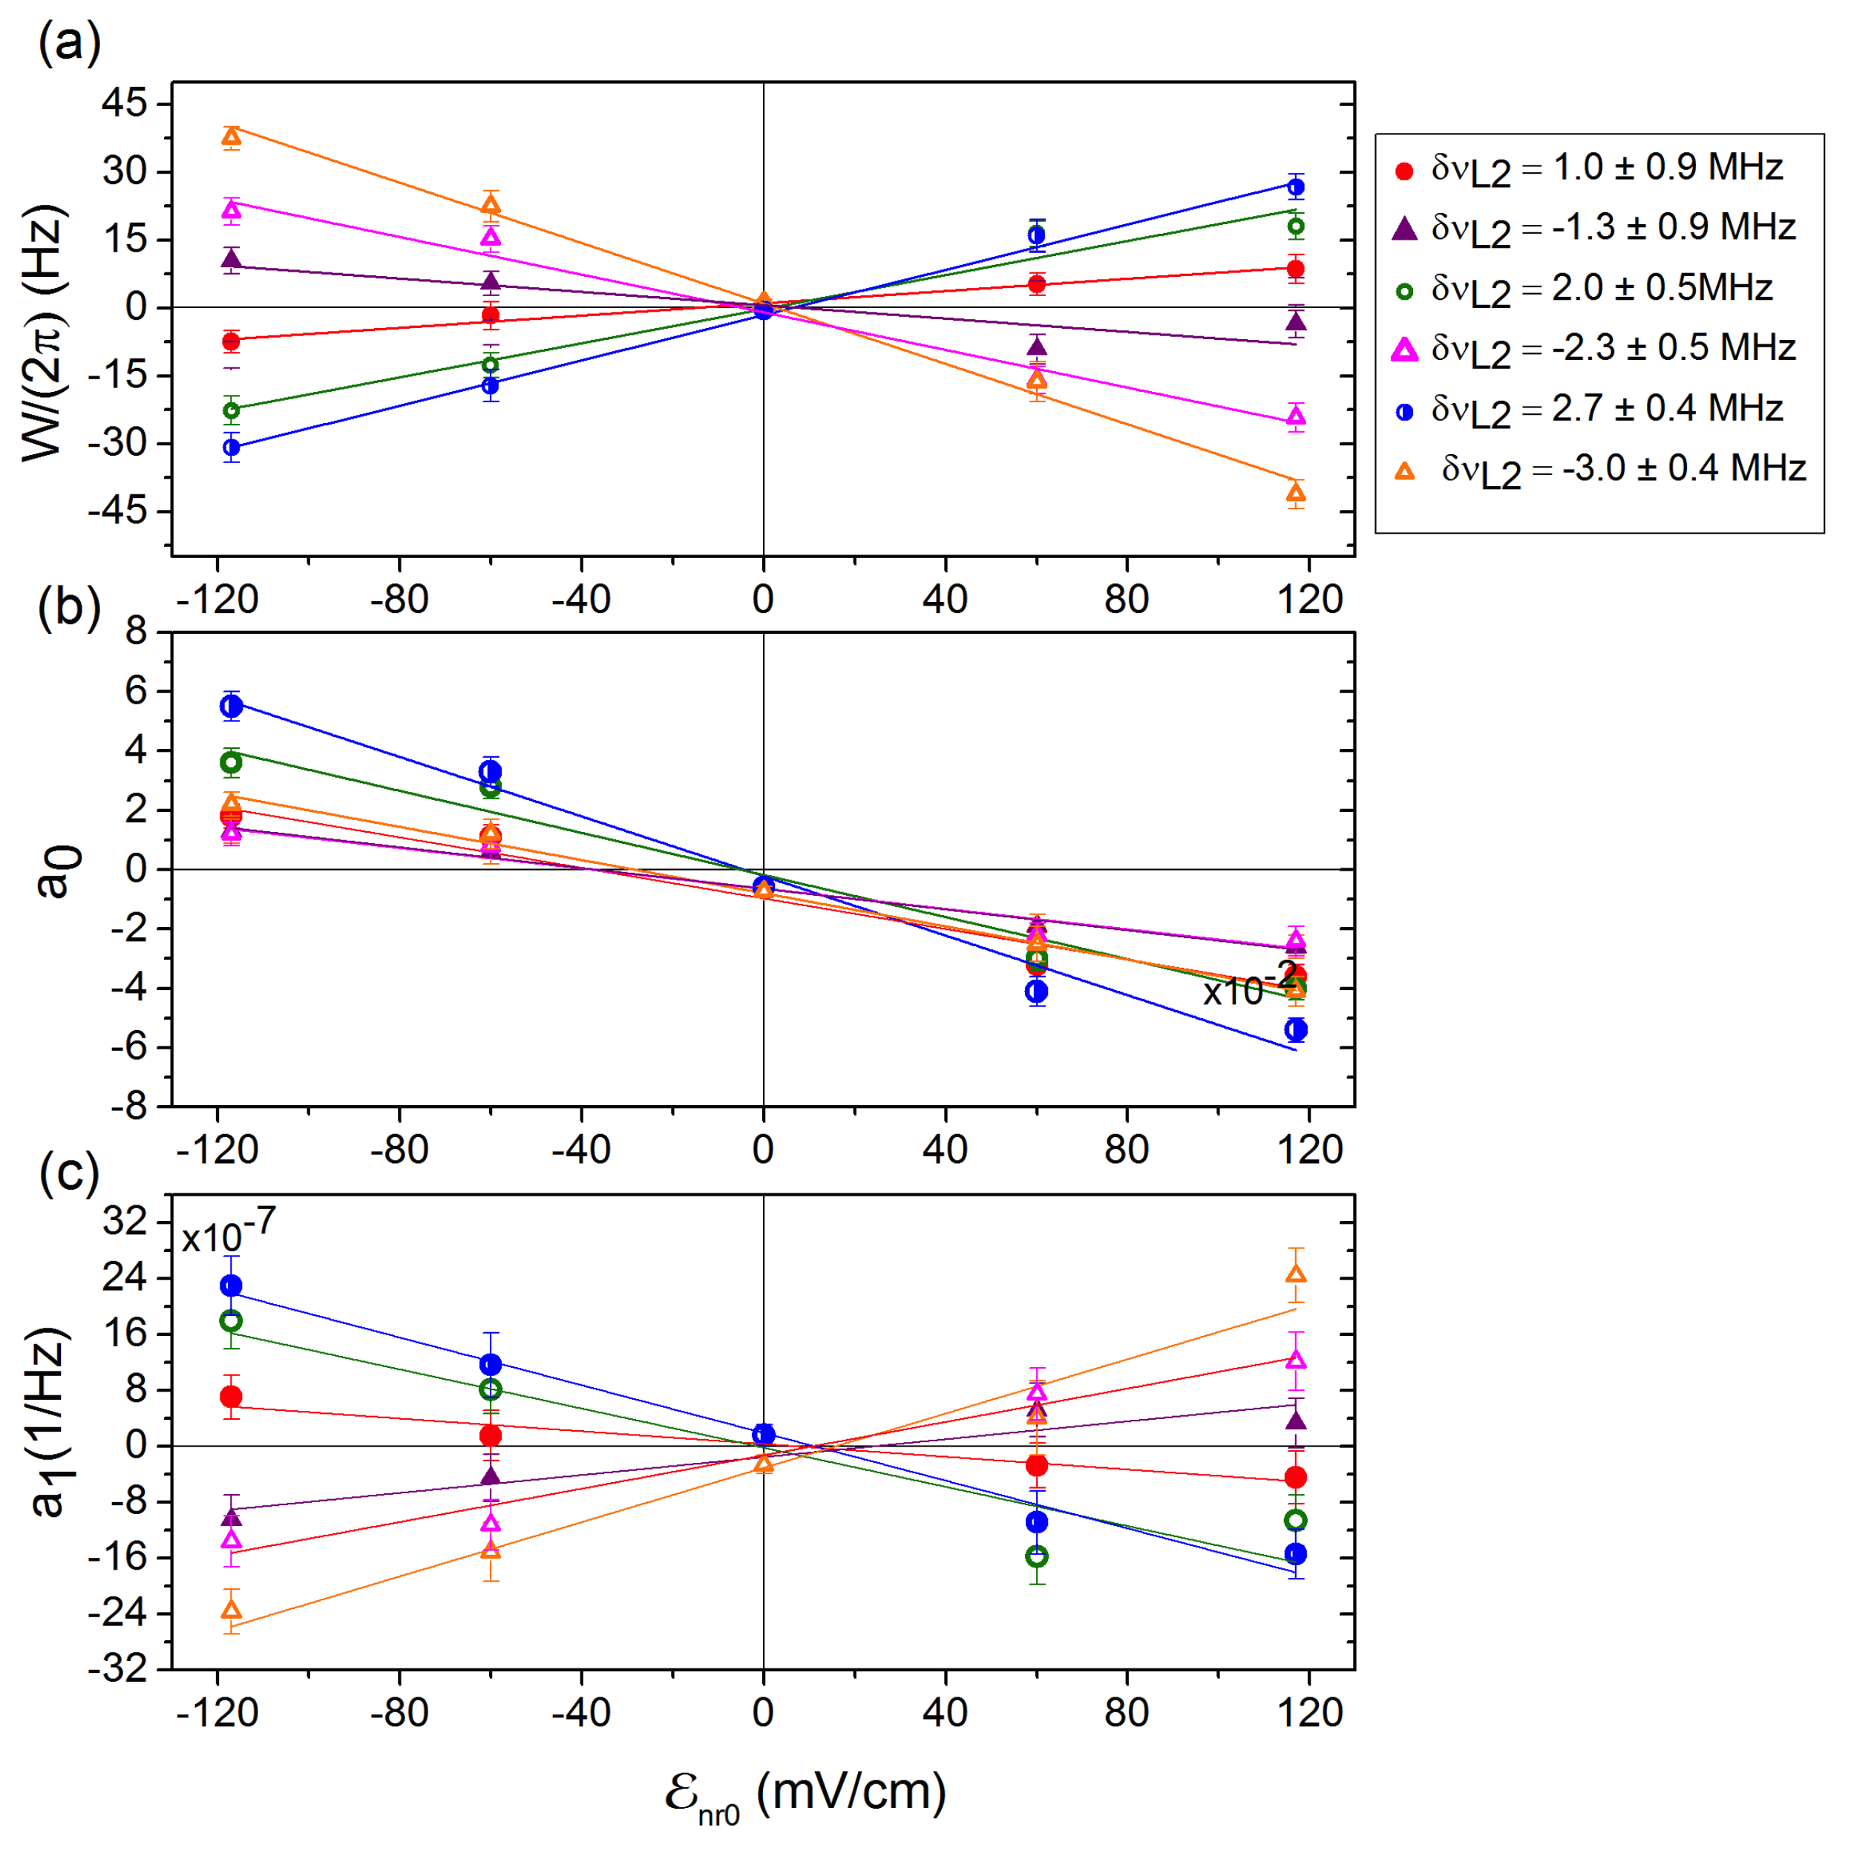
Experiment vs Simulated

Slide 4
Simulated
Analytic

Slide 5
(a)
(b)
(c)

Slide 6

Original
Before
After
$W/2π$ [Hz]
(a)
(b)
(c)

Slide 7

Original
Mod
$W/2π$ [Hz]
(a)
(b)

